Slide 1
SPINDLE Project
Disruption Tolerant Networking R&D
Rajesh Krishnan
krash@bbn.com
On behalf of the SPINDLE project team:
BBN: Rajesh Krishnan, Stephen Polit, Ram Ramanathan, Prithwish Basu, David Montana,
Regina Rosales Hain, Vikas Kawadia, Joanne Mikkelson, Talib Hussain, Mitch Tasman, Partha Pal, and Daria Antonova
UMR: Prof. Don Wunsch, Prof. Larry Pyeatt, Tae-hyung Kim
DARPA DTN Program Technical Interchange Meeting
August 02, 2005
This work is supported by the DARPA Advanced Technology Office under the DTN program.
© 2005 BBNT Solutions LLC

Slide 2
Role within DTN Program
System integrator for program
  build upon DTNRG work to assemble DTN Phase 1 system
  demonstration and performance evaluation
  feedback technology, insights, and lessons learned to DTNRG
Perform research in disruption tolerant networking
  routing in networks subject to disruption
    application of learning techniques (UMR talk this afternoon)
  late binding of names to destination identifiers
  policy based resource utilization
Key value additions anticipated
  knowledge base, routing, late binding
  evaluation platform

Slide 3
Implementation Architecture
Builds directly upon the DTNRG work and DTN2 implementation
  identifies system requirements
  extends Late Binding concepts (e.g. intentional naming)
  distinguishes data, control, and knowledge components
Maps requirements to (existing) DTN2 capabilities
  drives BBN extensions for Phase 1 system implementation
Released to DTN performers
  received comments from UIUC, Lehigh, and JPL
  no major disagreements
  some differences
    call out resource management and movement control modules
    service names map to endpoint IDs in revised Bundle Protocol Spec

Slide 4
Phase 1 System Software
Bundle processing core uses DTN2
Adding following components and related APIs:
  baseline adjacency discovery protocol
    discover and characterize adjacencies over underlying L2/L3
  baseline routing module
  persistent (deductive) knowledge base
    store, infer, and retrieve richly structured network information

Slide 5
Adjacency Discovery
Discovered adjacencies are critical to tactical networks
Discovery issues may be specific to underlying network
  thus, solutions must take them into account
A related problem is adjacency characterization
  characterize availability, delay, capacity, reliability, etc.
  applies also to static, scheduled, on-demand links
    motivates a general adjacency management API
More details on adjacency discovery later

Slide 6
SPINDLE Routing Architecture
Objectives
Create a routing and forwarding framework that allows a variety of routing mechanisms to be integrated into the SPINDLE system and evaluated
  emphasis on modular decomposition for easy swap in/out of independently developed mechanisms
  multi-level API definition for routing, forwarding in progress
Decouple functionality so that we can vary one aspect of the solution while keeping others the same
Align with DTNRG notions as much as possible
  e.g. for fragmentation, custody control, COS queuing etc.

Slide 7
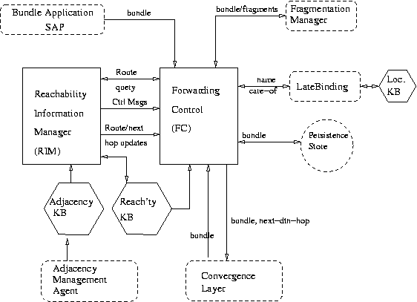
High-level Modules and Interfaces
Control
Components
Data
Components
Knowledge
Components
Note: Architecture
document describes
a finer-grained
decomposition

Slide 8
SPINDLE Routing Approaches
QuikRoute: Baseline SPINDLE routing protocol. Goals:
  getting a complete system up and running ASAP
    support static, discovered, and scheduled adjacencies
  being a baseline for comparing other solutions
  being an example instantiation of our architecture and APIs
FansyRoute: More sophisticated alternative for SPINDLE. Goals:
  single routing mechanism based on constrained replication and “fan-out” of bundles
  works like standard link-state in stable conditions, flooding in highly disruptive conditions, and adapts based on uncertainty of links
  consider storage, capacity, and expiry time in controlling behavior
  framework to bring in best ideas from academic community
    e.g. erasure/network coding, robotic networks, predicted links

Slide 9
Persistent Knowledge Base
A basic knowledge base capability, a key element of our approach
  extends persistence and deductive database capabilities to adjacency, reachability, and naming information in addition to bundle metadata
  based on a Frame-Logic formalism, built on top of a tabled Prolog engine
Why a deductive database approach?
  powerful query features
  declare complex schedules but keep query interface simple/uniform
    explicit: Adj [from -> “n1”, to -> “n2”, upAt -> 9346750].
    expression: Adj [from -> “n1”, to -> “n2”, upAt -> U] :- U is next_noontime.
    query (in both cases): Adj [from -> F, to -> T, upAt -> U].
  can use engine for routing, late-binding, and to reason about policy
    e.g. we have QuikRoute and QuikLB implemented as an example
  this approach will make it easier to tie-in mission specifics
Plan to share API and implementation with DTNRG/DTN performers

Slide 10
Persistent Knowledge Base
Details
Implemented as a replacement to DTN2 storage module
  based on Flora-2/XSB with MySQL RDBMS accessed via ODBC
  stores bundles as BLOBs in RDBMS, and bundle metadata in KB
  keys are strings (considering future use of OWL URIs)
Features
  general add, delete, and query methods in PeristentKBModule
  utility methods for handling adjacency, reachability, naming, bundle metadata
  callbacks to various modules can be registered with the KB
    e.g. when query succeeds with a minimum specified number of answers
  automatic storage maintenance
    callback when storage (almost) full, purge when expired
Issues
  learning curve for declarative approach
  performance in tiny embedded systems

Slide 11
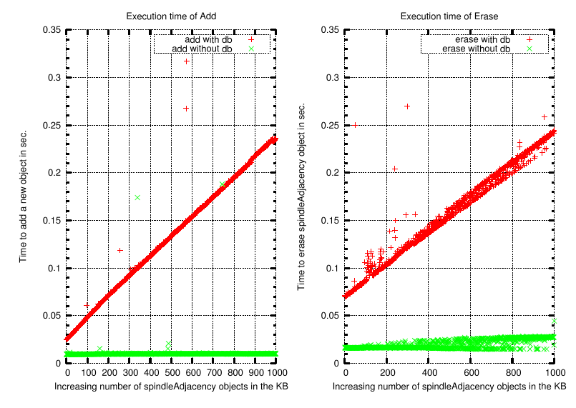
Persistent Knowledge Base
Preliminary Performance Evaluation*
Insert
Delete
The flexibility and power of Flora-2/XSB comes with a performance penalty
  can sustain 50--100 insert/deletes per second
Use of backend DB (for continuous persistence) affects performance
  need to aggregate writes
Time (in seconds)
Time (in seconds)
Number of Adjacencies in KB
Number of Adjacencies in KB
Green: Without Persistence, Red: With Persistence
* 2GHz P4 CPU with 1G RAM running Linux

Slide 12
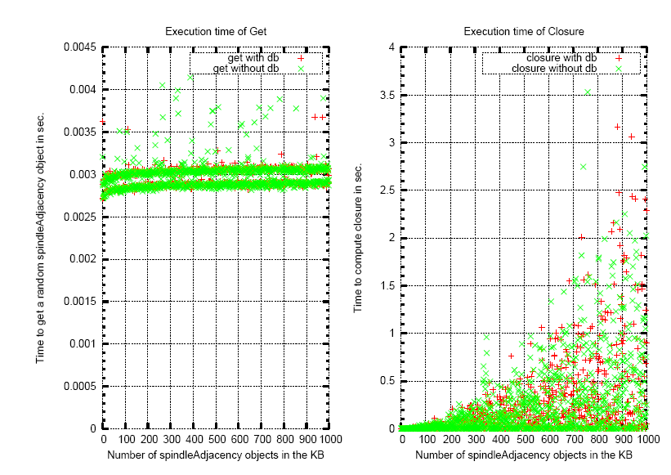
Persistent Knowledge Base
Preliminary Performance Evaluation
Simple Query
Transitive Closure
Persistence does not affect performance of get as information is kept in memory
  300+ gets per second
Transitive closure (test if two nodes chosen at random are connected) can take a long time to compute, but this is as expected
  e.g. O(n^3) for Floyd-Warshall algorithm
Time (in seconds)
Time (in seconds)
Number of Adjacencies in KB
Number of Adjacencies in KB
Green: Without Persistence, Red: With Persistence

Slide 13
Late Binding in SPINDLE
Provides two key services to routing in disruptive environments
  map target names (not known to routing) to canonical names (that are routable)
    examples of names: intentional/role based names
    examples of name attributes: GPS coords @ time t, UAV flight plans
  bind underlying convergence layer interface, address, and related parameters to an adjacency
    e.g., routing may operate on coarse-grained information about a future adjacency but convergence layer bindings may be deferred until the bundle is to be forwarded
Approach takes advantage of knowledge base
  details later

Slide 14
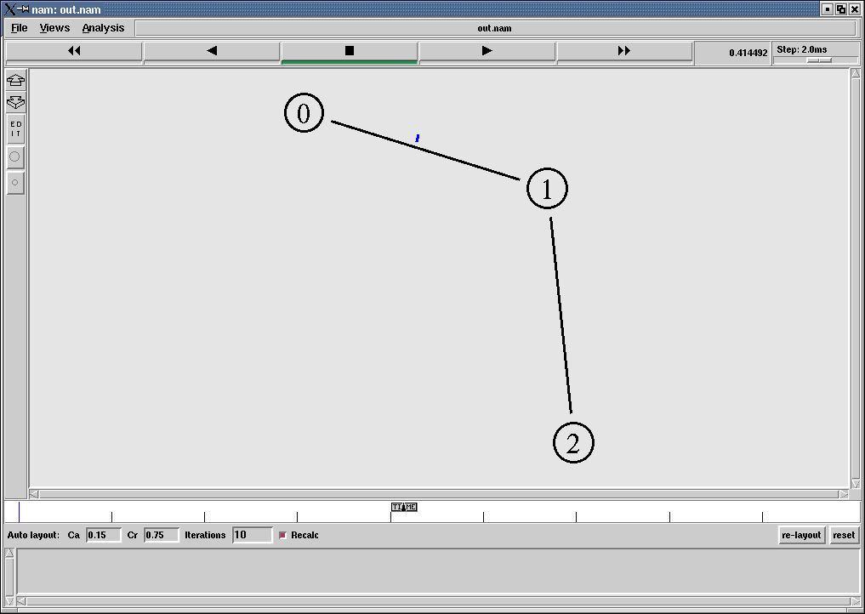
DTN Phase 1 Evaluation Platform
Approach: Combine OS Virtualization and Simulation
UserModeLinux1
UserModeLinux2
UserModeLinux3
Simulation Script (ns2)
Set up nodes, interfaces
Set up link characteristics
(p2p / broadcast)
Set up mobility models
Configure traffic agents
(start bundle apps)
Configure routing
Schedule adjacencies
(commands to dtnd)
dtnsend
dtnrcv
dtnd1
dtnd2
dtnd3
Link layer packets
Simulation Manager (based on extensions to ns-2)
manage interactions with user-mode linux
  start processes, access interfaces, access dtnd CLI
  maintain convergence layer mappings
  interfaces/addresses to ns2 node-id/slots
copy link layer packet to appropriate interface
  after simulated loss/delay and error through network
Visualization using nam
Host OS (Linux)
Trace
Run multiple DTN system instances on a single machine
  use User-Mode-Linux for OS virtualization
  connect via virtual Ethernet bridge, pass real bundle traffic through simulated network
Evaluate over simulated DTN network scenarios with mobility and disruption
  simulations written in ns-2, can use most ns-2 features

Slide 15
DTN Phase 1 Evaluation Platform
Status
Basic evaluation platform now working
  dtnd, dtnsend, and dtnrecv tested with five DTN nodes
    simulated network can be larger
  nttcp tests: 1.25 Mb/s over 2 Mb/s 802.11 net in ns-2
    on Intel 2.45 GHz P4 running Linux
  leverages recent (Dec 2004) work on ns-2 wireless emulation
    by Daniel Mahrenholz, U. Magdeburg†
Additional features to be added
  ability to invoke commands in virtual OS and dtnd from ns-2
  scenario scripts along with required ns-2 modifications
  instrumentation for metrics
To be released for use by DTN performers
†http://www-ivs.cs.uni-magdeburg.de/EuK/forschung/projekte/nse/index.shtml

Slide 16
Schedule
Architecture,
DTN2 Evaluation
System Design
Virt./Sim. Impl.
System
Impl.
Test/Scenario Impl.,
Documentation
Experimentation
2
5
6
1
3
4
7
Feb 15
Aug 15
Nov 15
Jan 15
Mar 15
Milestones
1. Architecture: Apr 30
2. API Specification*: Aug 15
3. Virt./Sim.: Aug 15
4. Software Beta: Nov 15
5. Software Release: Dec 30
6. Go/No-Go: Jan 15
7. Draft Final Report: Mar 15
Funds expended: 42% of BBN portion
as of 07/24.
*Delayed from Jul 30

Slide 17
Adjacency Discovery
Vikas Kawadia

Slide 18
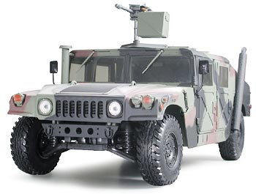
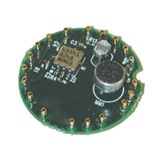
The need for discovery in DTNs
Transmission opportunities may not be known in advance and may be short-lived
It is critical that they be automatically discovered and quickly availed
A passing vehicle presents
a short-lived communication
opportunity to nodes in a
wireless sensor field
Notes:
Mention another example of a UAV flying over an ad hoc network

Slide 19
Adjacency discovery
We wish to discover DTN adjacencies
  these may correspond to a multi-hop path in the underlay
A related problem is adjacency characterization
  up/down status, delay, bandwidth, reliability etc.
  applies also to static, scheduled, on-demand adjacencies
    motivates a general adjacency management API
Discovery and characterization deal with variables which are convergence layer specific
  thus, the solutions must take the convergence layer into account

Slide 20
Convergence layer services for Discovery
Discovery requires means to convey information to potentially ‘adjacent nodes’ without explicitly addressing them
  A suitable dissemination mechanism must be provided by the convergence layer or one may need to be added
Convergence layer dissemination mechanisms
  one-hop broadcast mechanisms
    802.11 ad hoc mode: physical layer broadcast
    802.3 Ethernet: subnet broadcast
  network wide dissemination mechanism
    Link status update messages in MANET routing protocols
  Indirect mechanisms
    Publish/subscribe

Slide 21
Solutions for some convergence layers
Link layer broadcast
  Adjacency discovery is equivalent to neighbor discovery
Ad hoc networks
  Piggy back on routing updates or opaque LSA like, when possible
  Design and deploy a network wide dissemination service
Large IP networks
  Need to scope discovery
  Server based publish subscribe mechanisms
  IP Multicast
  Peer-to-peer technologies

Slide 22
Architecture
Adjacency Management Module
AKB
API for discovery
Discovery
module
Discovery
module
…
CL 1
CL k

Slide 23
Discovery API
Provided by the Adjacency management module (AMM)
  Discovery module in each CL inherits from AMM and implements the functions
  virtual int startDiscovery(ConvergenceLayer cl);
  virtual int stopDiscovery(ConvergenceLayer cl);
  virtual int startCharacterization(SpindleAdjacency sa, int level);
  virtual int stopCharacterization(SpindleAdjacency sa, int level);
  virtual int characterizeAdjacency(SpindleAdjacency sa, int level);
Functions for other types of adjacencies
Provided by the AMM to the CLs to access the AKB
  int updateAdjacency(SpindleAdjacency sa);
  int downAdjacency(SpindleAdjacency sa);

Slide 24
Roadmap
Problem studied and characterized
API development in progress
Implementation
  Neighbor discovery is straightforward
  A mechanism will be implemented for an ad hoc network
    OLSR is a candidate
  Possible future work
    An efficient dissemination service
    Large IP networks

Slide 25
Late Binding
Prithwish Basu

Slide 26
Late Binding in SPINDLE
Problem: coalition force member addresses a bundle to target name:
  squadronLeader@{org=US Army, loc=36N,43E}
  canonical name John.Smith@unit101.us.army.mil is not known
Provides two key services to routing in disruptive environments
  Map target names in a namespace with attributes (not known to routing) to canonical names that are routable
    e.g., Intentional/role based names
    Physical location/trajectory attributes: GPS coords @ time t, UAV flight plans
  Bind an adjacency to convergence layer interface, address and params
    coarse grained information about a future adjacency may be used by routing
    actual CL binding deferred till a bundle is to be forwarded
These functions often need to be performed late in a DTN

Slide 27
Name Resolution Approach
Architecture includes resolver nodes
  Store/update attribute-rich names to canonical name bindings
  Communicate occasionally in a disruptive environment
Name resolution information stored in a persistent deductive DB
  Name KB has well specified and dynamically extensible ontology
  Name KB allows querying to resolve attribute-rich names
Progressive resolution
  Resolvers forward bundle to other potentially better resolvers
Operation under disruption/delay is key
  Efficient dissemination and synchronization of time-sensitive information
  Dynamic KB management

Slide 28



QuikLB Algorithm
backup cmd center
Intentional name: CC
Canonical name: T2
main cmd center
Intentional name: CC
Canonical name: T1
Resolution query:
S?(type=chem/bio; locbox=B)
S6
S1
knows that V1,V2 can resolve
and knows their trajectories;
returns V1 as resolver
late binding happens
when V1 is here
publish attributes
(GPS, sensor type)
aggregate and
disseminate
T1 down
sendto: CC
map CC -> T2
to: T1
S2
S3
coordinate
box : B
V1
S4
Canonical Node Names
cmd center: T1/T2
data mules: V1, V2
UGS: S1 – S6
S5
V2
publish attributes
(GPS, sensor type)
publish attributes
(GPS, sensor type)

Slide 29
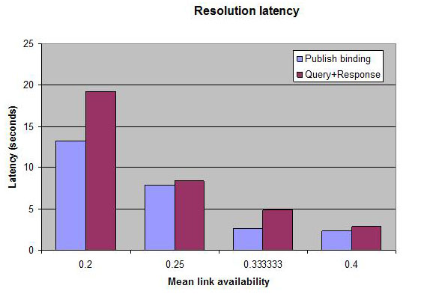
Preliminary Simulation Results
4 x 5 mesh
a -> 1
20
13
a -> ?
a
1
Other Variables
Number of resolver nodes in DTN
Dynamicity of bindings
Other Metrics
Control overhead (extra bundles)
Scalability with increase in #names

Slide 30
Current Status
Architecture defined and released to performers
API defined for registration/resolution/dissemination
Simulations ongoing in ns-2 using KB rules in Flora-2
Resolution functionality being developed using a declarative approach
  Using KB (Flora-2) integrated with Spindle DTN system
Integration of LB functionality in Phase 2

Slide 31
Research Issues
Impact of different update dissemination strategies in a DTN environment
Some Fundamental questions:
  What to send in the update (full binding info or meta info)
  Who to update (which resolvers, elect additional resolvers?)
  When to update (temporally aggregate or not)
    Dissemination may be content aware
  How to update
    Unicast along a resolver overlay topology
    Spindle layer broadcast
Incorporating uncertainty measures in name binding information

Slide 32
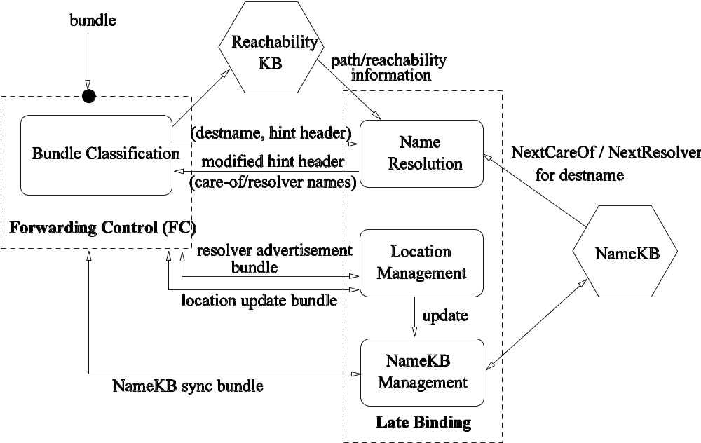
Architecture
Routing Module
Attribute
Management
attribute update bundle

Slide 33
Discussion

